Slide 1
Desktop Assistant for Gaming
Bailey Goins
Eren Bikmaz
Lehi Briggs
Morgan Anderson

Slide 2
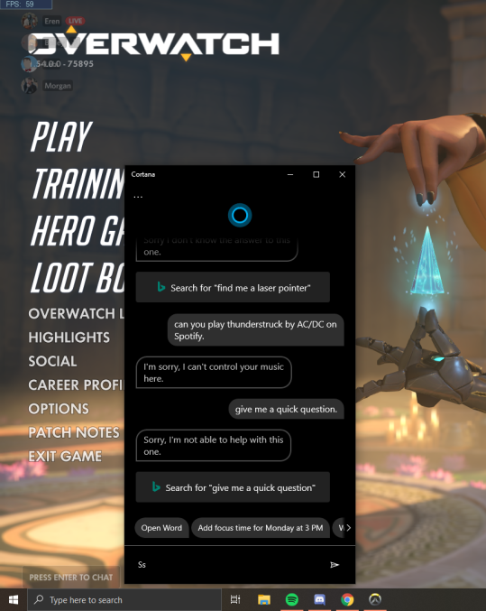
Our Project
A general focus on the gaming demographic
Overlays
Controlling second screen with voice commands
Integration with popular software used by the gaming demographic
Notes:
Bailey

Slide 3


Sprint Goals
Produce an efficient development routine (Jira, Git, etc...)
Select frameworks for all parts of our project
AI
GUI / Overlay
Desktop scripting
Connecting logic?
Connect these frameworks to get a functioning skeleton
Notes:
Eren

Slide 4
Sprint Results
We were successfully able to get a speech engine to communicate with a GUI
In doing so we have found frameworks for our…
GUI (Electron)
Backend (Node.js)
Speech Recognition (Google Suite via C#)
We’ve organized Git/Jira
GUI (Electron)
Backend
(Node.js)
Speech AI (Google Suite C#)
Notes:
Lehi

Slide 5
Demo
We will now demonstrate our speech recognition engine interacting with our GUI engine.
Notes:
Lehi

Slide 6

Goals of our “holiday jog”
Fill in the gaps from our previous sprint
Overlay demos
Desktop scripting demos
Increase familiarity with Javascript, html, and github
Become familiar with different sections of code
Notes:
Morgan

Slide 7
Questions, Comments, Concerns?
Notes:
Eren

